Slide 1
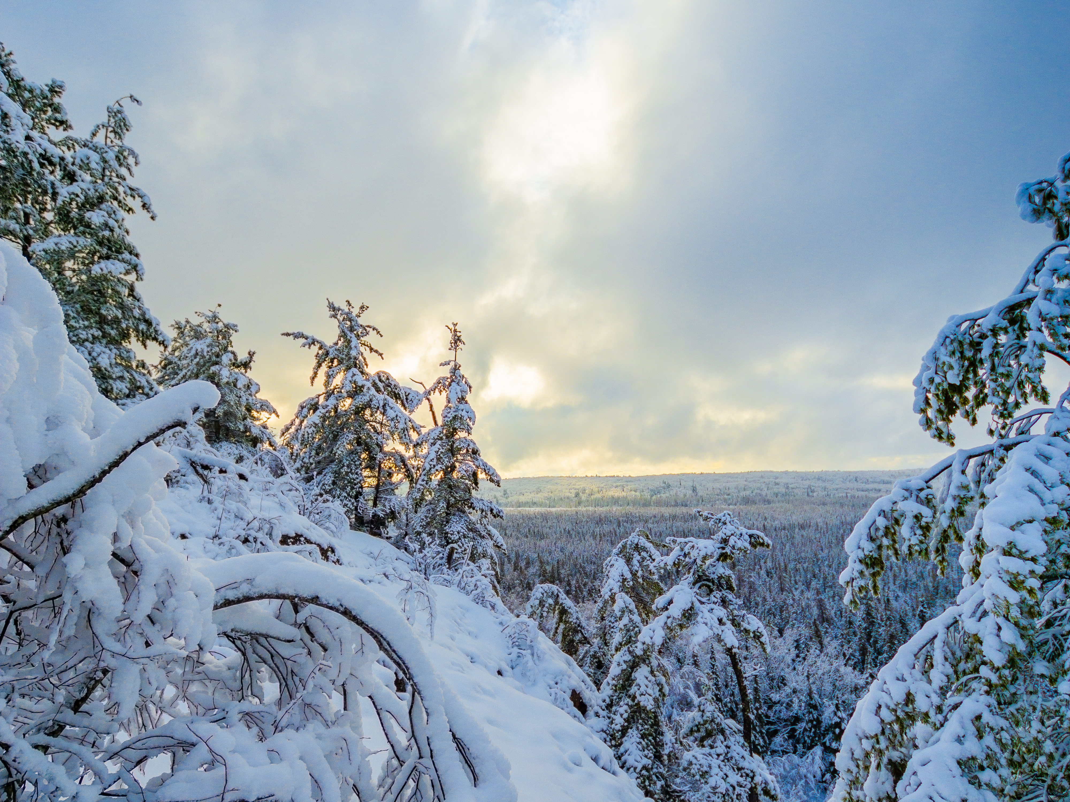


NORTHERN ONTARIO
COVID-19
SURVEY
RESULTS
MARCH 23, 2020

Slide 2
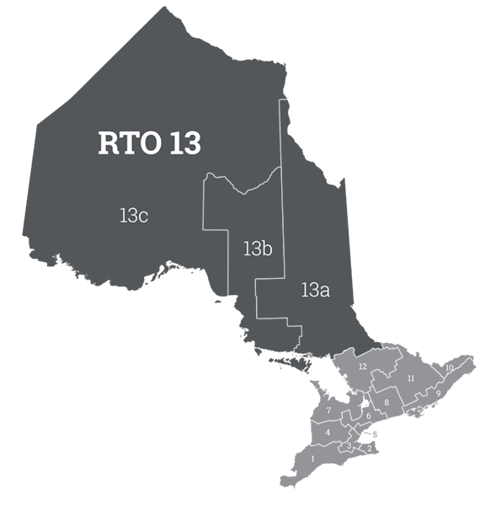
COVID-19 SURVEY RESULTS
Revenue
Loss
* Based on data collected between March 18th and 23rd.
Total: -$ 8,831,996

Slide 3
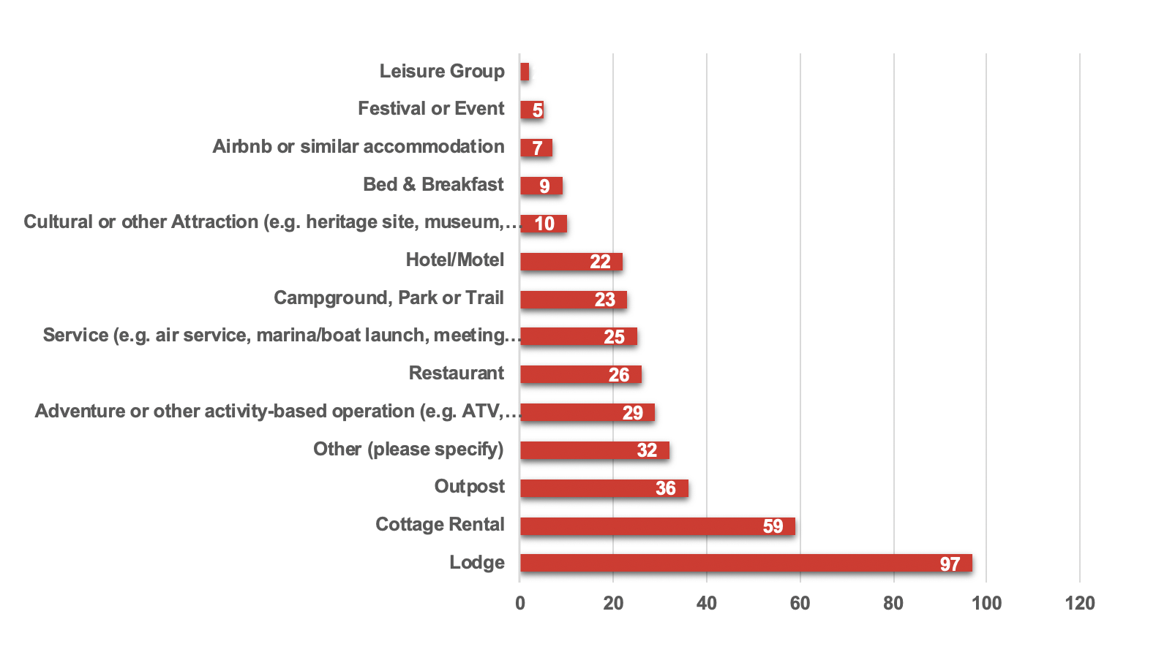
COVID-19 SURVEY RESULTS
Breakdown by sector:
* Based on data collected between March 18th and 23rd.

Slide 4
COVID-19 SURVEY RESULTS
Travel Cancellations to Northern Ontario by Origin:
* Between March 18th and 23rd.
GUEST LOCATION
#Cancellations
Canada
United Kingdom
U.S.A.
Total
161
1
9
188

Slide 5

COVID-19 SURVEY RESULTS
Reasons for travel cancellations:
Fear of spreading/contracting COVID-19
Border closures
Events postponed
Layoffs

Slide 6
COVID-19 SURVEY RESULTS
Reasons for travel cancellations:
Fear of spreading/contracting COVID-19
Border closures
Events postponed
Layoffs

Slide 7


COVID-19 SURVEY RESULTS
What the industry
is saying:
“We are unable to afford operating expenses, mortgages, necessary repairs, etc.”
“90 to 95% of our guests are U.S. citizens. If this virus continues we may loose our whole season.”
“We have laid off 90% of our staff.”

